Slide 1

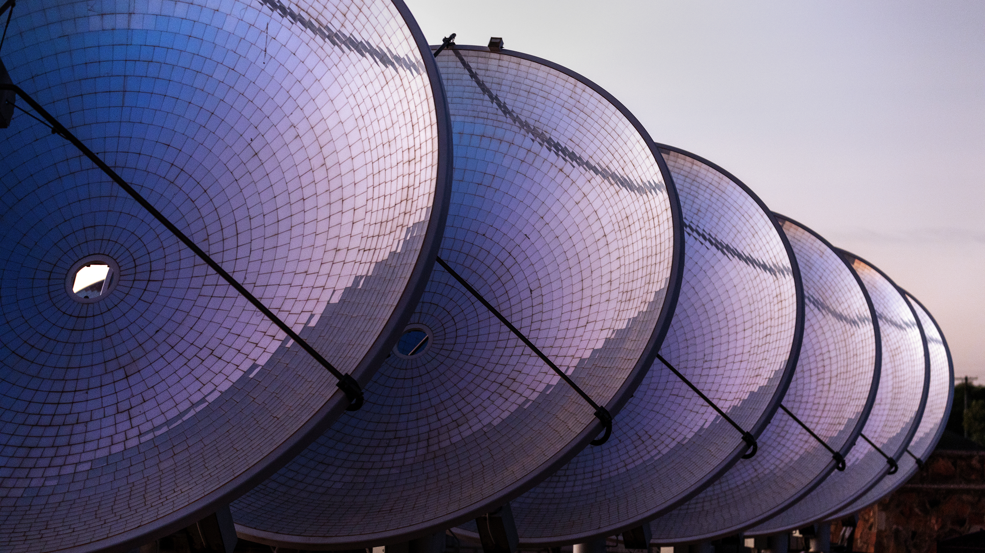
Implementation of a Dual-Axis Tracking System for Parabolic Dish Collectors
By: Ahmed El Araby
Thesis advisor: Dr. Yehia Eissa

Slide 2
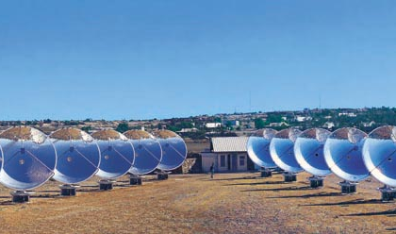
Outline
Introduction
Methodology
Results & Implementation
Conclusion

Slide 3
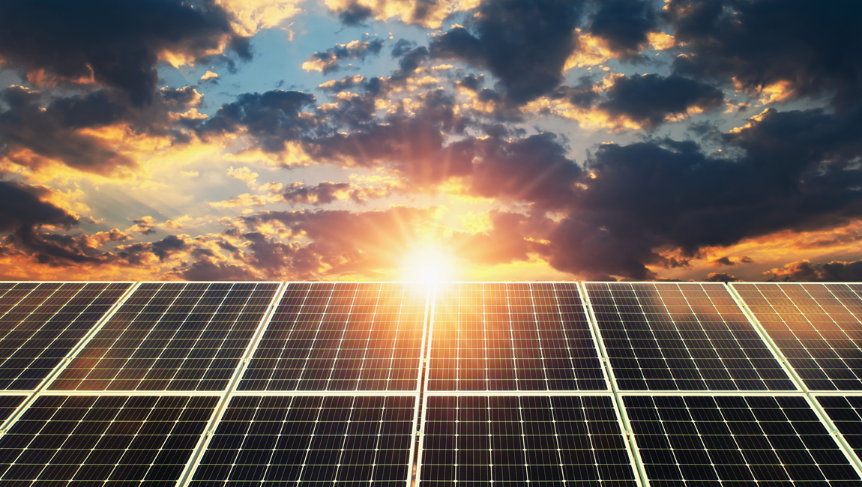
Introduction
Importance of Solar energy
Solar energy growth
Types of solar energy sources
What is a solar tracker (technologies and DoF)
Aim

Slide 4
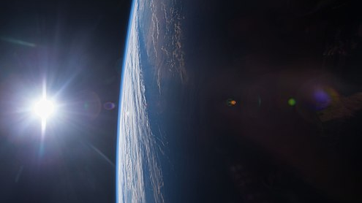
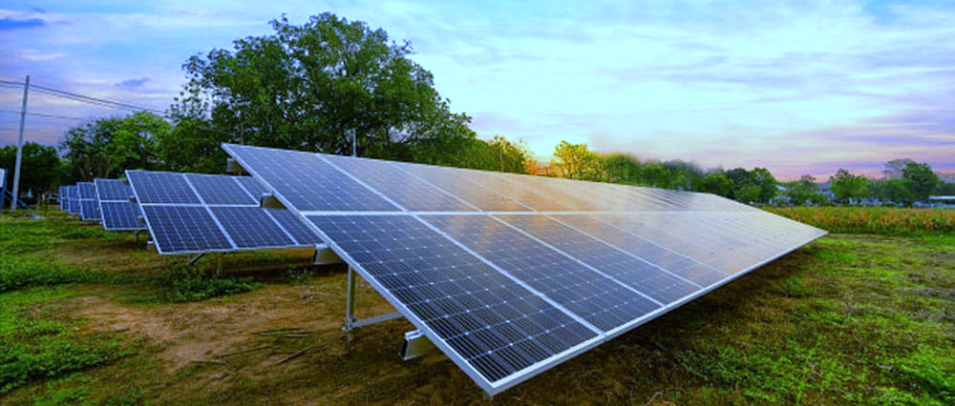
Importance of Solar energy
Solar energy is radiant light and heat from the Sun that is harnessed using a range of technologies such as solar power to generate electricity, solar thermal energy and solar architecture[1].
Limitless solar energy
Saves money
Clean source
Notes:
Solar power is the key to a clean energy future and play crucial role in decar­bonization of our societies. Every day, the sun gives off far more energy than we need to power every­thing on earth.
Saves money: Financial returns and lower monthly utility bills are major incentives for going solar, Moreover, installation costs has substantiall decreased over the years

Slide 5
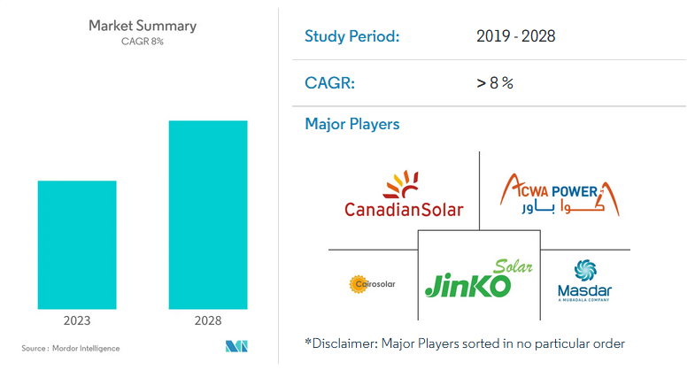
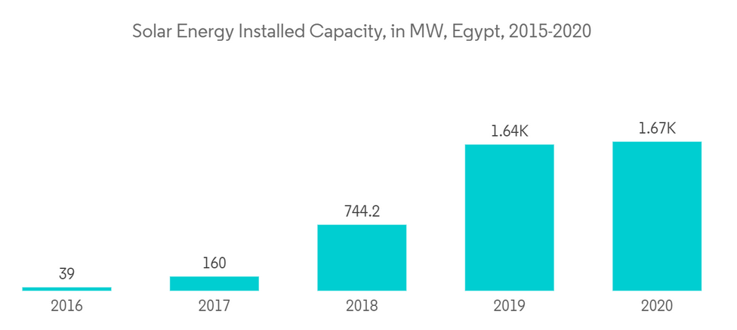
Solar energy growth
The Egyptian Solar Energy Market is segmented by Technology (Solar Photovoltaic (PV) and Concentrated Solar Power (CSP))[2].
Solar energy installed capacity, in MW ,Egypt, 2015-2022
Notes:
The Egyptian solar market is expected to register a CAGR of more than 8% during the forecast period, 2022-20.27. CAGR (Compound annual growth rate)
The government has formulated plans under its National Renewable Energy Strategy to increase the share of renewable energy in the national energy mix to 20%by 2022 and further double it to 42% by 2035.

Slide 6
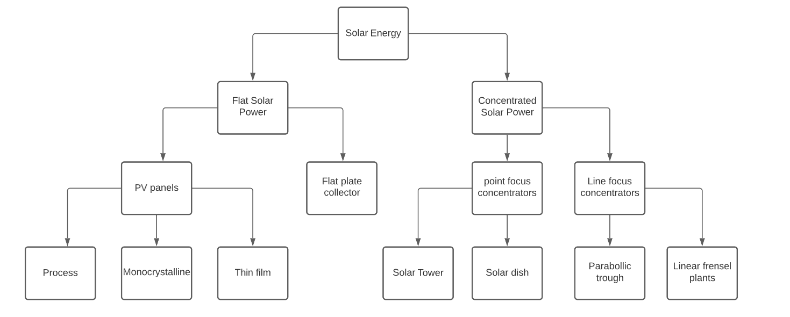
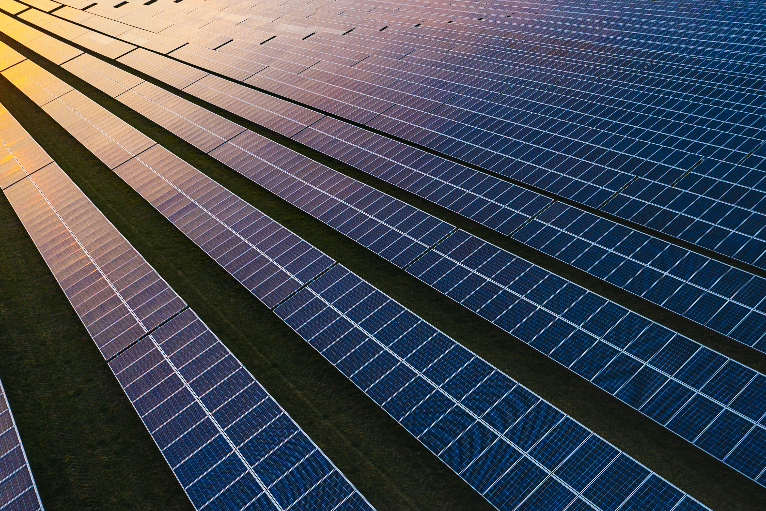
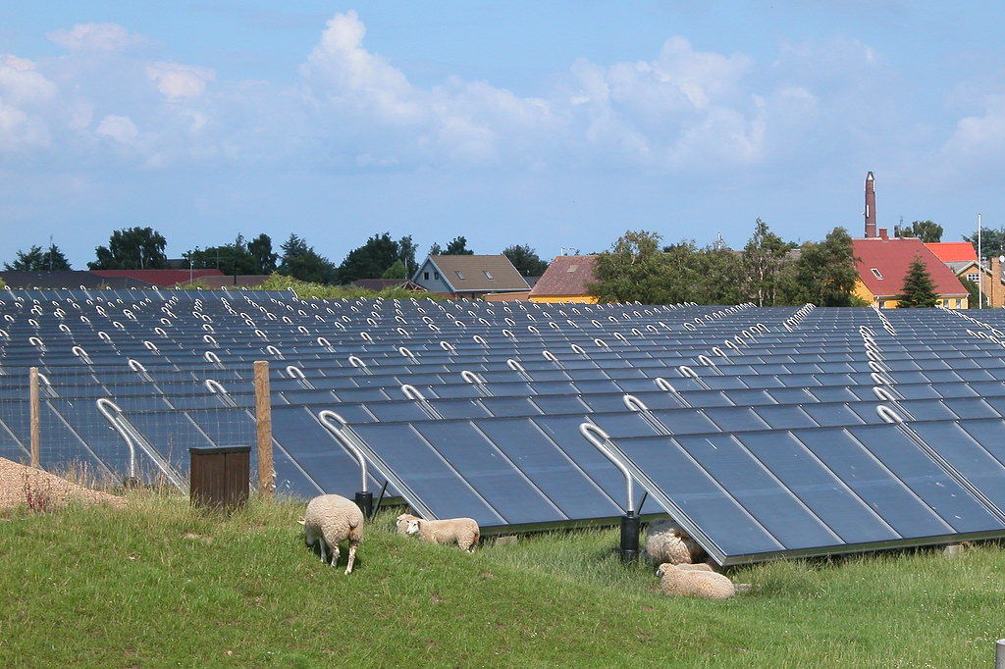
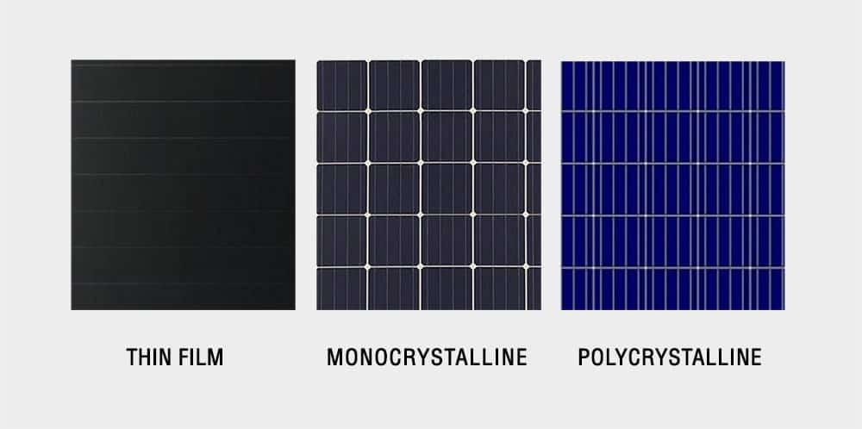
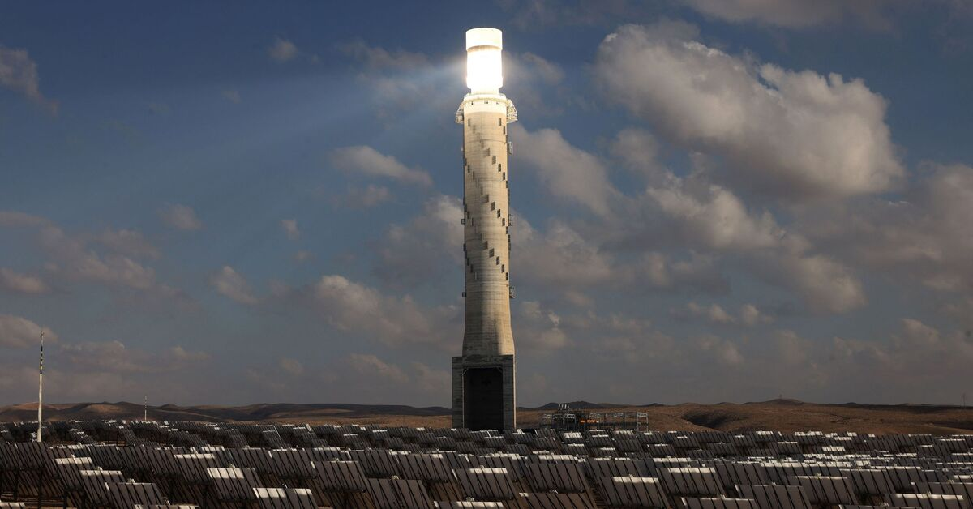
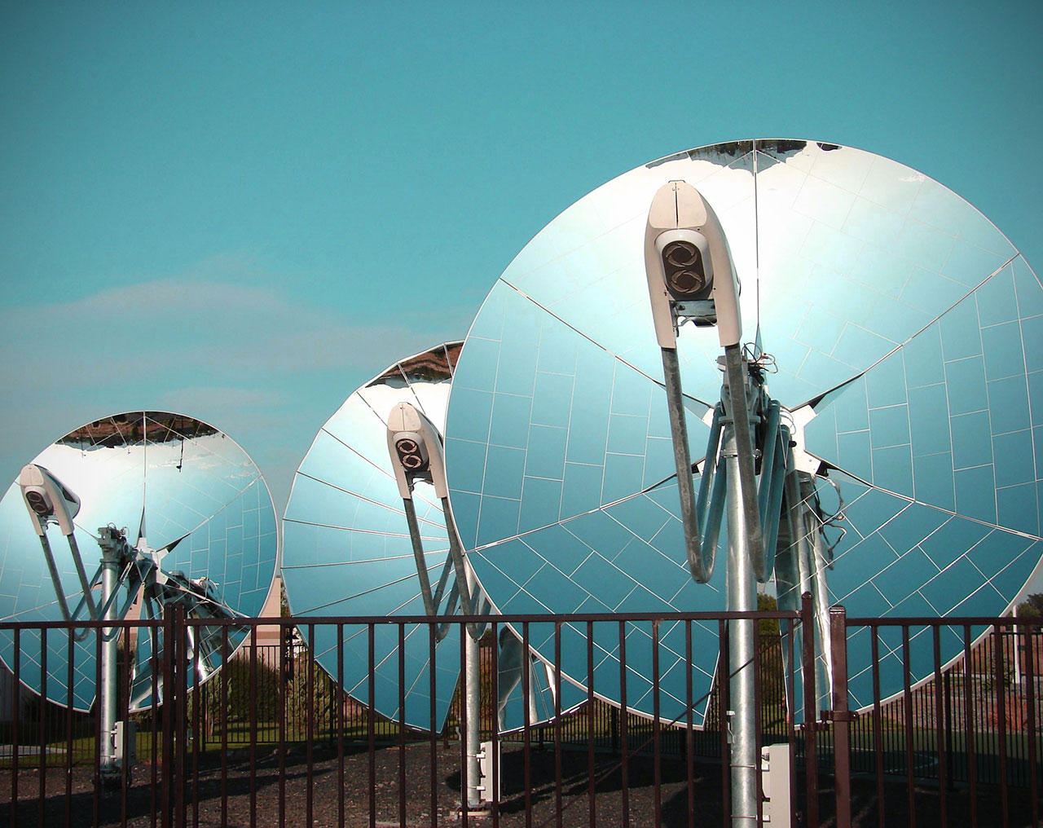
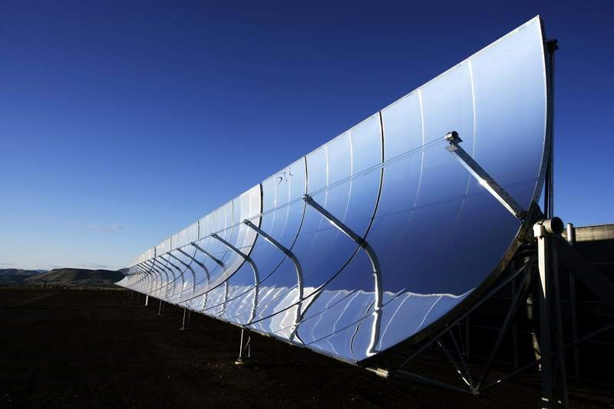
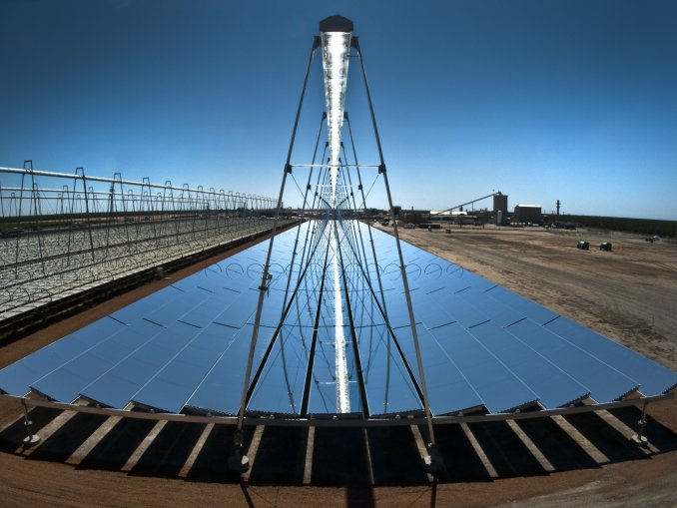
Types of Solar energy generation

Slide 7
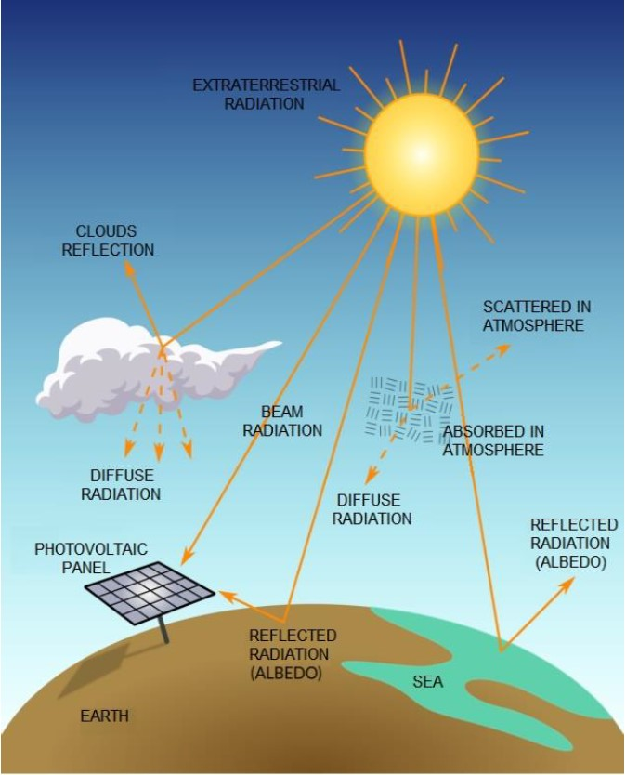
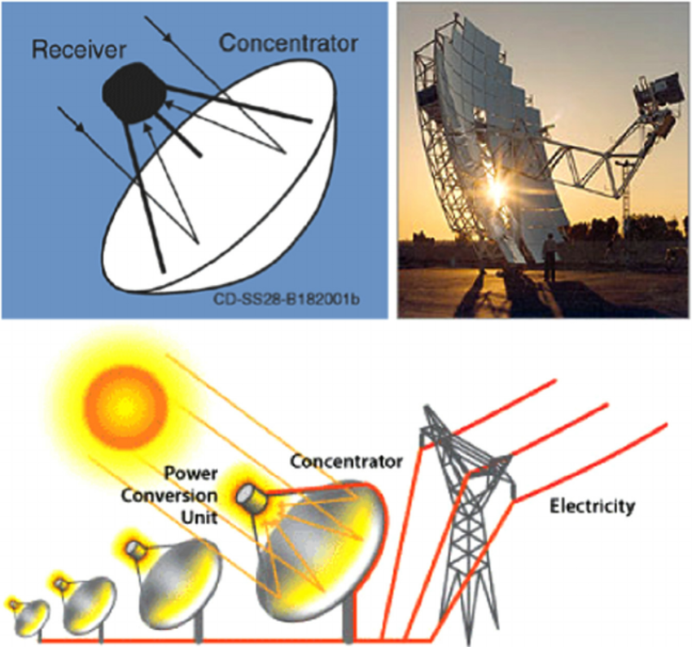
Types of solar radiation
Notes:
The solar radiation that fills our sky can be direct, diffuse or reflected radiation.
Reflected radiation describes sunlight that has been reflected off of non-atmospheric things such as the ground. Asphalt reflects about 4% of the light that strikes it and a lawn about 25%.
When the sky is clear and the sun is very high in the sky, direct radiation is around 85% of the total insolation striking the ground and diffuse radiation is about 15%.

Slide 8
Solar tracking technologies
Active solar tracking
Passive solar tracking
Chronological solar tracking

Slide 9
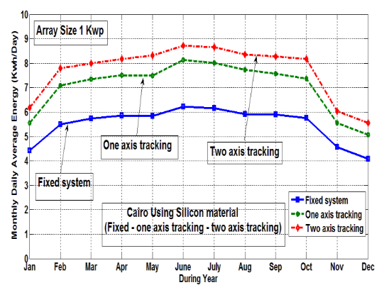
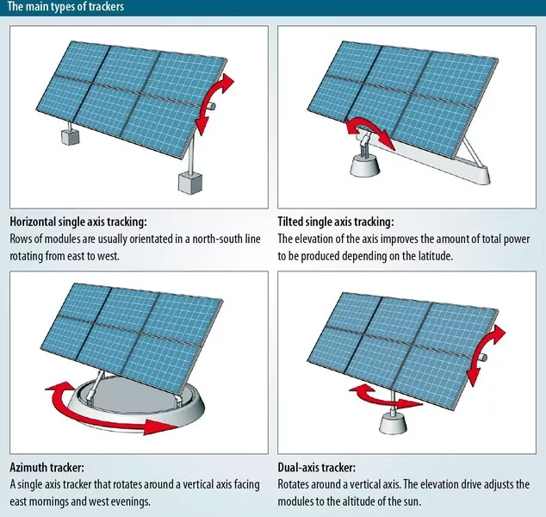
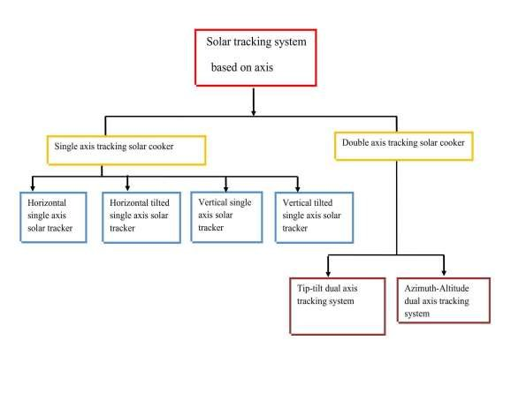
Solar tracking DoF

Slide 10
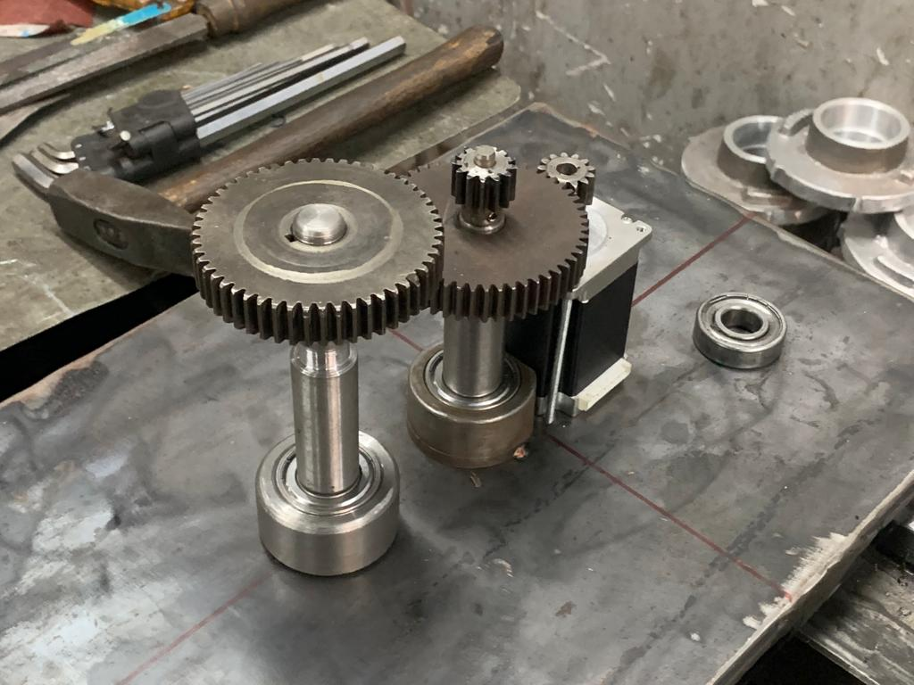
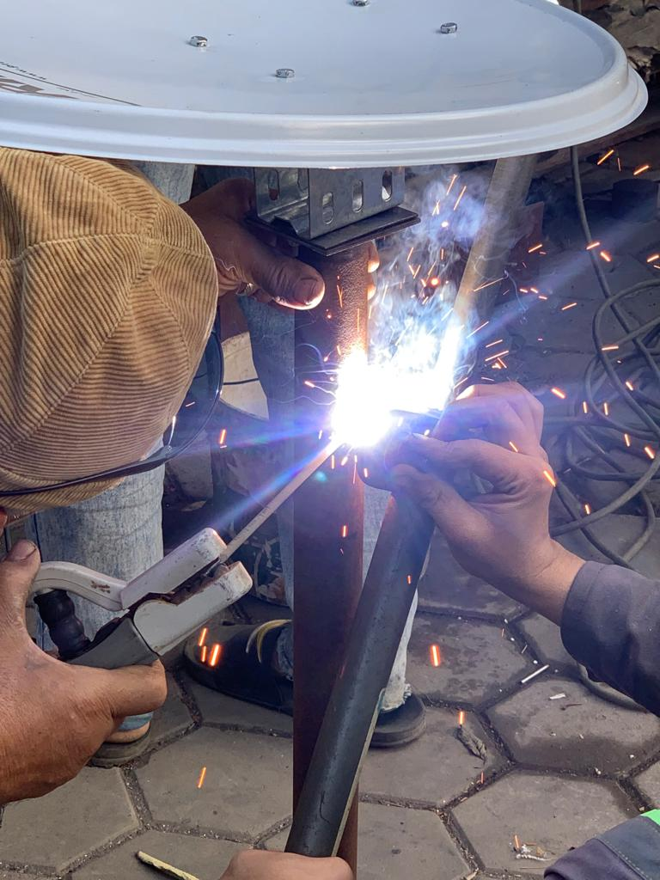
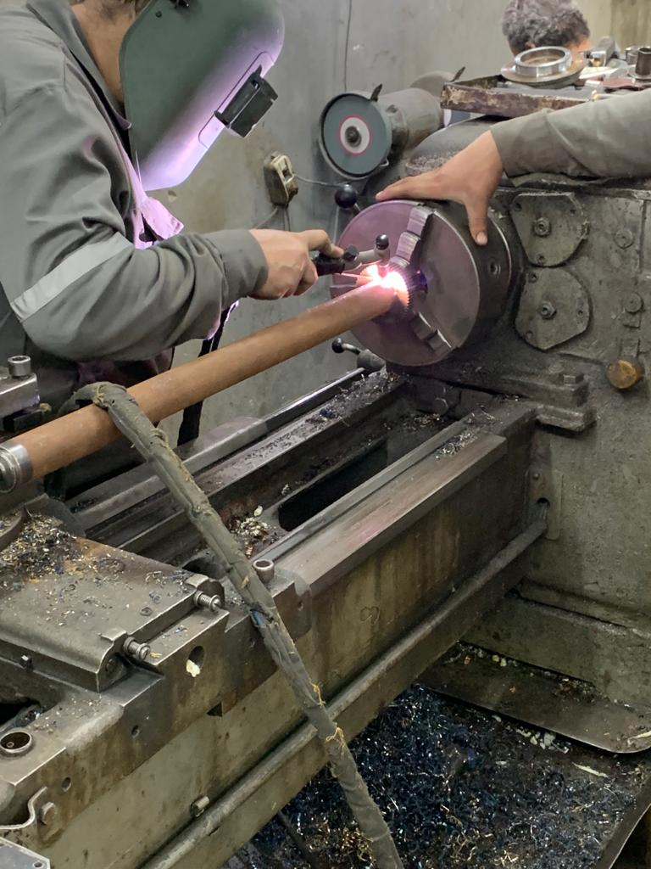
Aim
The aim of this study is to construct an open-loop dual-axis solar tracking system that follows chronological technology and examine its implementation challenges in the Egyptian industry.

Slide 11
Methodology
Solar Geometry
Software design
Hardware components

Slide 12
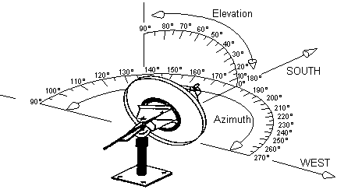
Azimuth and Elevation angles
Elevation angle
Azimuth angle

Slide 13
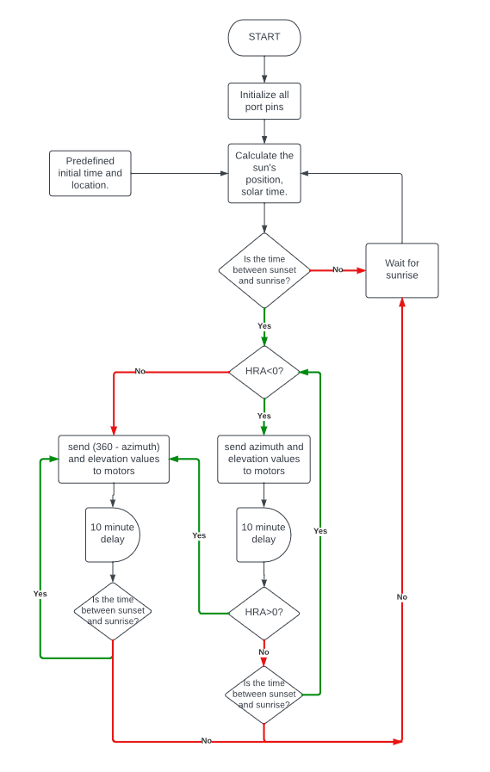
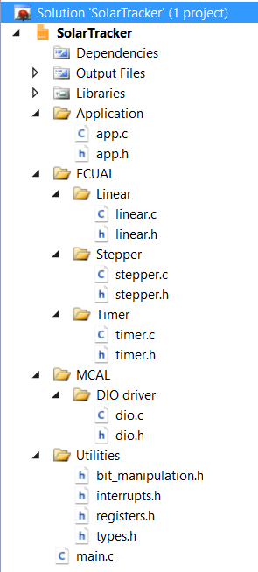

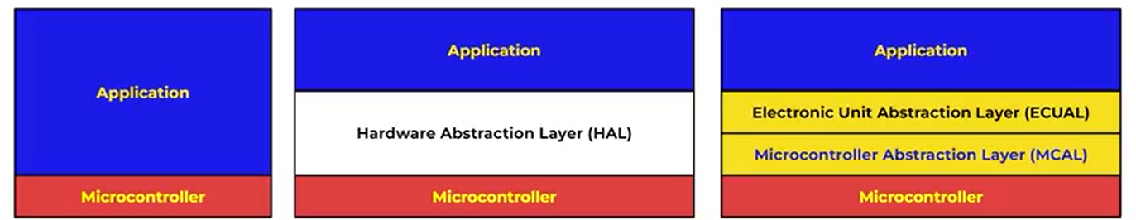
Software design

Slide 14
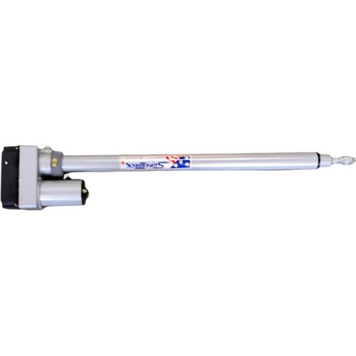

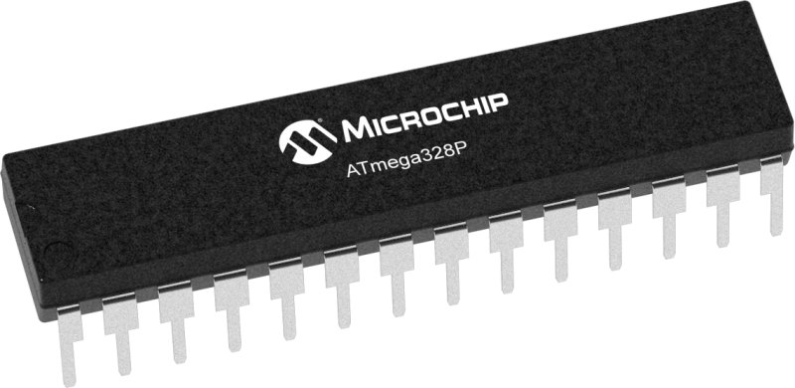
Hardware components
Superjack Linear actuator
NEMA 23 & TB6600 Driver
ATMega328 Microcontroller

Slide 15
Results
SolidWorks design of the system
Hardware Implementation process

Slide 16
Design of the system

Slide 17
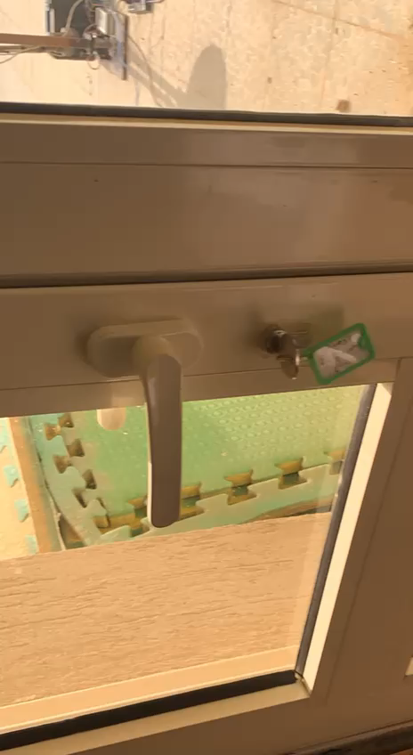
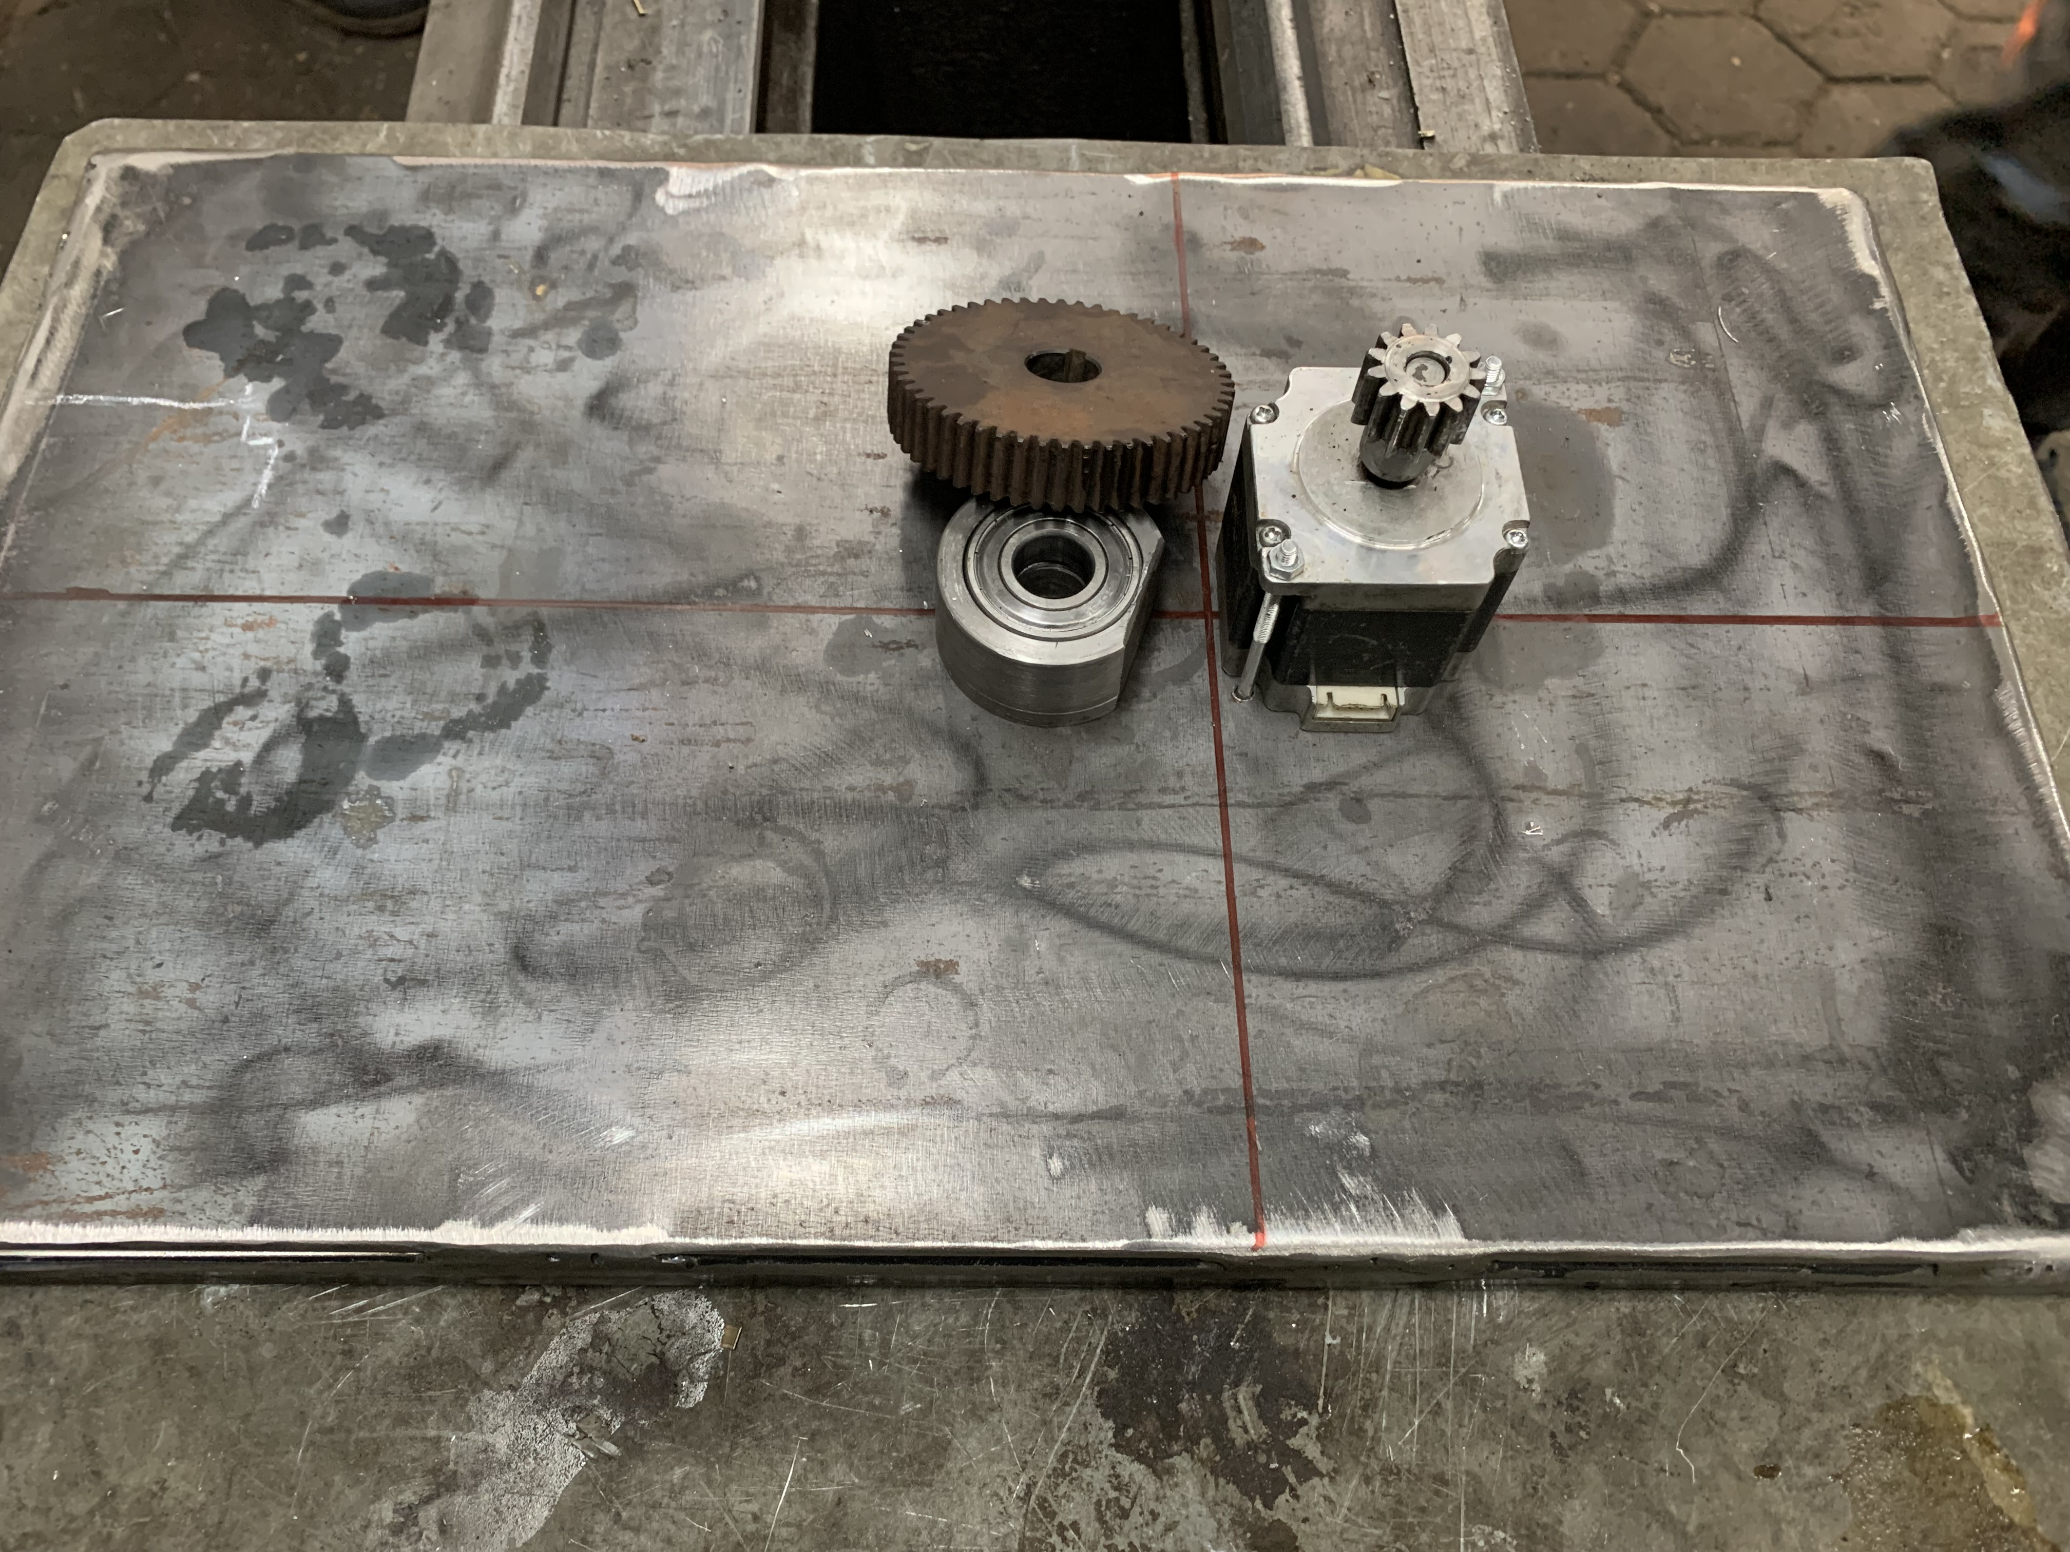
Hardware implementation process

Slide 18
Conclusion
Discussion
Future work

Slide 19
Conclusion and discussion
Implementing a PDC in the current market has been a hassle considering the limited options for the available motors, hence one must be creative with working with what’s in hand, which is the job of every engineer, problem solving.
This thesis proves that it is possible to implement a relatively large-scale PDC with high precision in dual axis with affordable finances any student can handle.

Slide 20
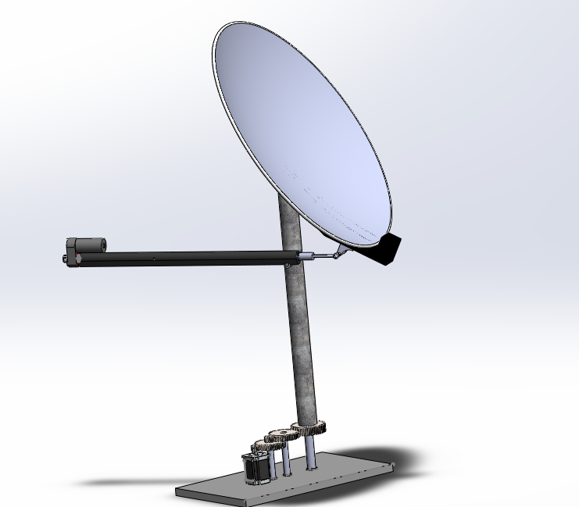
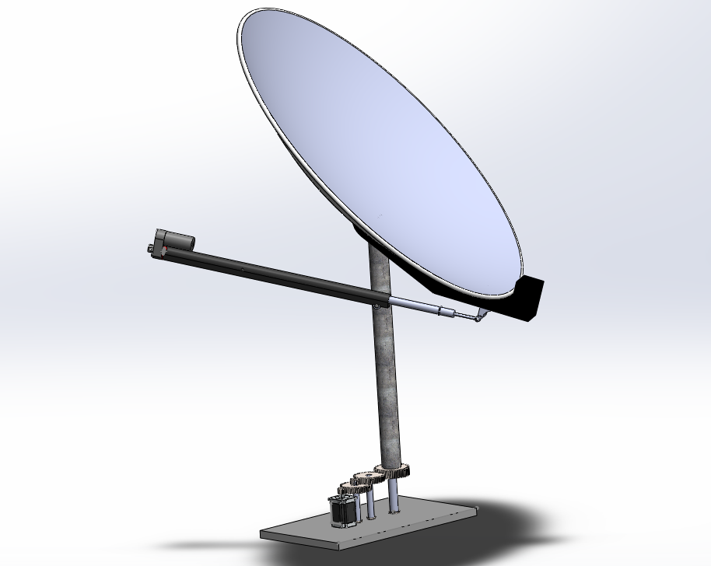
Future work
Firstly, a larger dish is recommended, since the larger is the surface area of the dish, the more DNI is reflected of the dish. Also, the weight of the dishes is not that much compared to the rest of the assembly.
Secondly, integrate light dependent resistors to the system to achieve active solar tracking along side chronological solar tracking, which much increases the accuracy of the system.
Last but not least, using a longer column supporting the dish, as the higher the dish is in altitude, the better is the collection of the sun and also avoids the shadows of any possible obstructing surrounding.

Slide 21
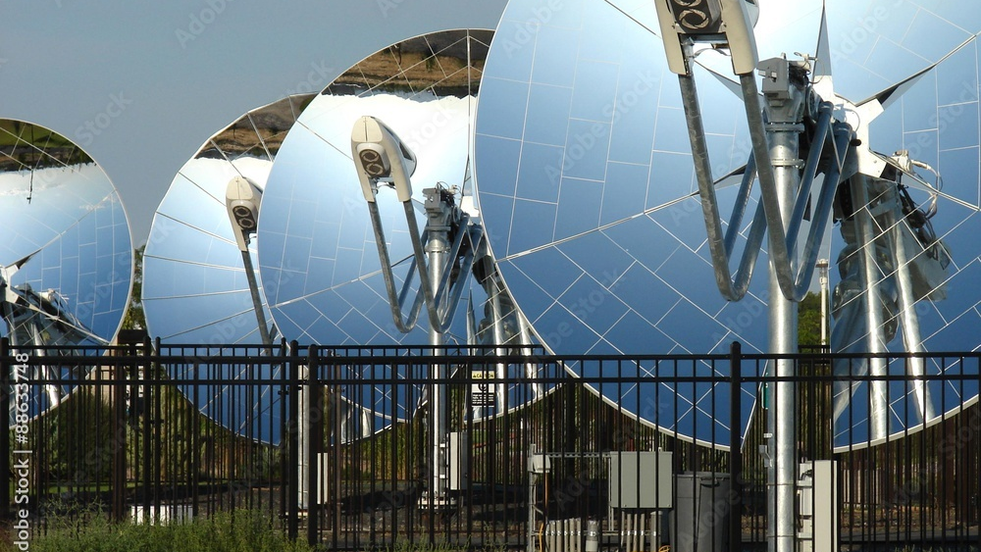
Thank you
Any questions?

Slide 22
References
[1] https://www.britannica.com/science/solar-energy
[2] https://www.mordorintelligence.com/industry-reports/egypt-solar-energy-market

